Slide 1
Carbon Tenement Squad
How the Global Carbon Cycle Works
Adaptation from - SLE740 Climate Change Adaptation and Mitigation

Slide 2
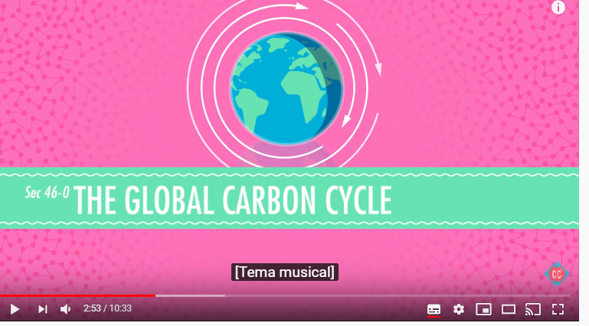
Useful link to understand how the global carbon cycle works:
https://www.youtube.com/watch?v=aLuSi_6Ol8M

Slide 3
Carbon cycle
Approximate composition of the dry atmosphere (excluding water vapour) is:
78% N₂
21% O₂
1% Ar
None of these components absorb infrared radiation (i.e. they are not greenhouse gases and therefore do not warm the surface of the planet).
Next largest component is water vapour, whose abundance varies with location. Up to 4% in the tropics, 0.2% in polar regions and 0.0005% in the stratosphere.

Slide 4
Carbon cycle
Water vapour is the most abundant greenhouse gas in the atmosphere.
Main source is evaporating oceans.
Removed when raindrops form and fall back to Earth.
Human emissions of water vapour contribute virtually nothing to its atmospheric abundance.
So that means N₂, O₂, Ar and H₂O make up 99.95% of the atmosphere.

Slide 5
Carbon cycle
The largest component of the remaining 0.05% is CO2, which (currently) constitutes 0.04% of the atmosphere.
Because 0.04% is such a small figure, scientists commonly use parts per million; 400 parts per million (400 molecules of CO2 in every million molecules of atmosphere).
Methane is next at 1.83 PPM.
Ozone at 10-40 PPB
Halocarbons at 3 PPM

Slide 6
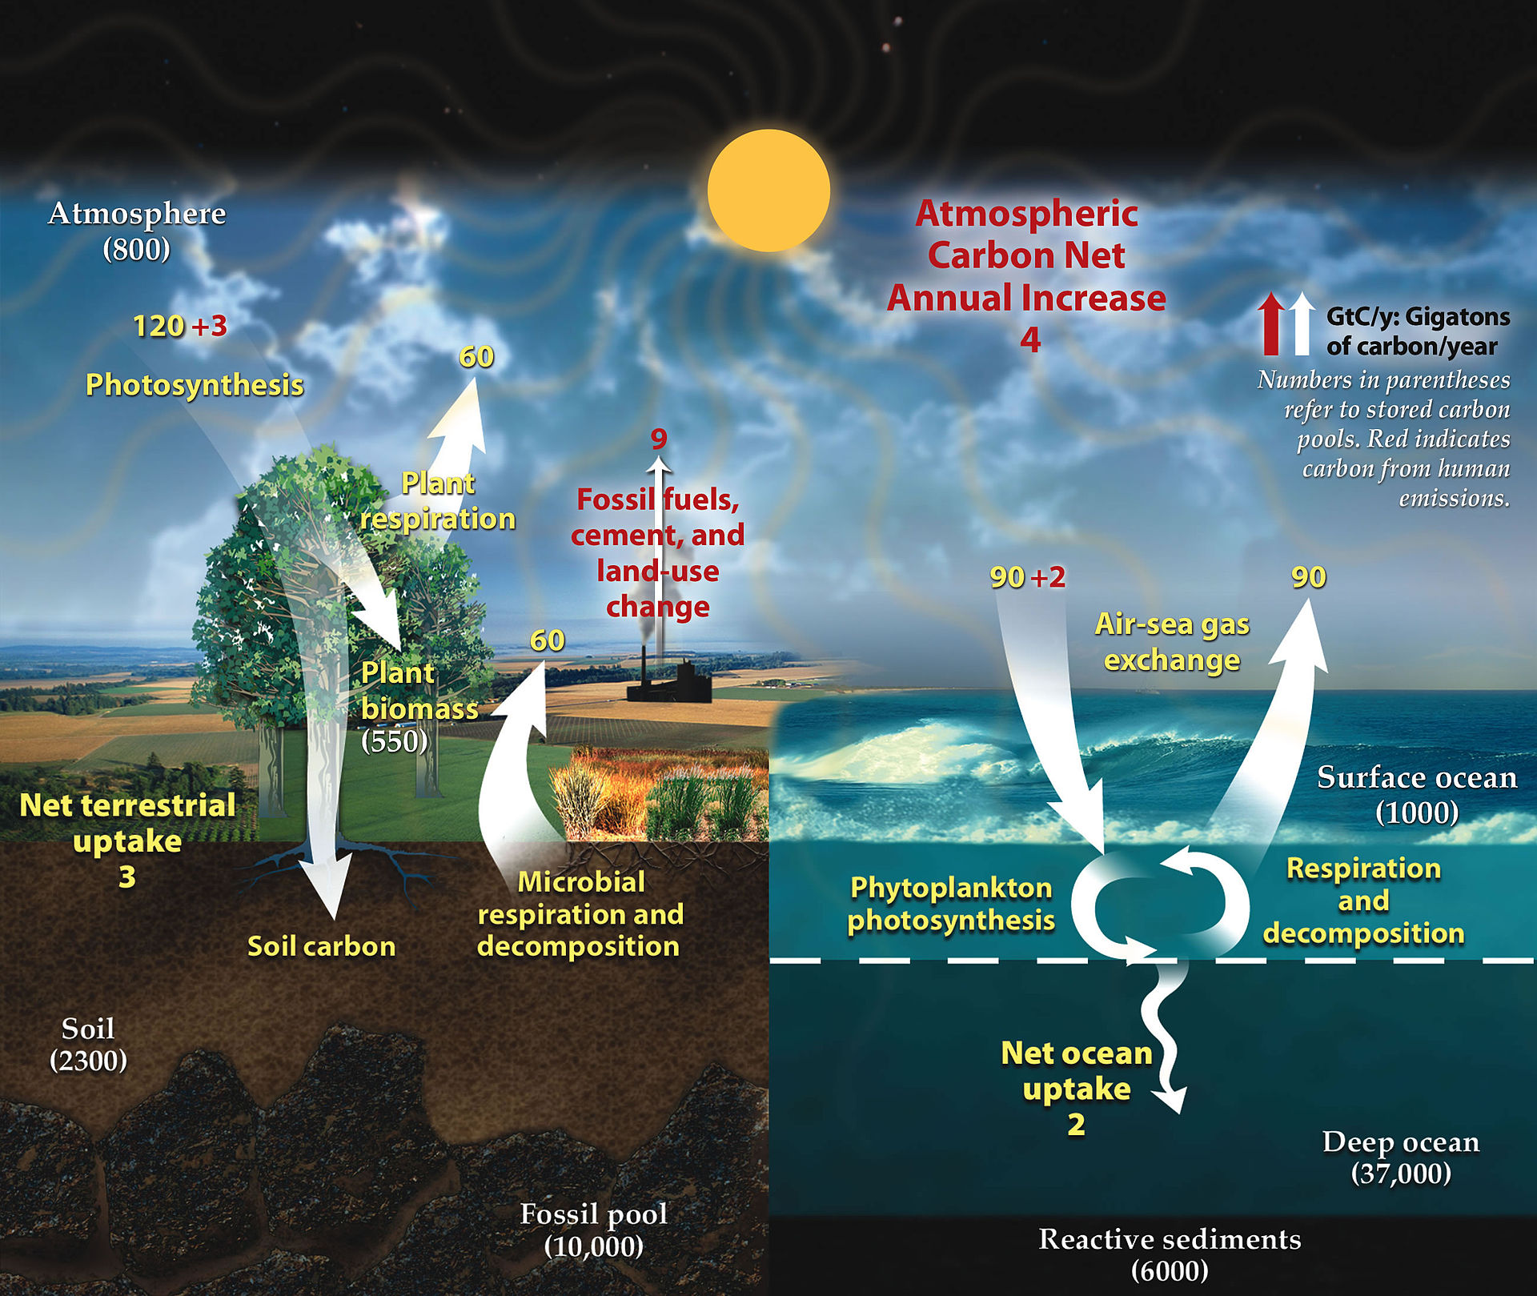
Carbon cycle
This diagram shows the combined atmosphere-land-ocean movement of carbon in GtC per year.
Yellow numbers are natural fluxes
Red are human contributions
White numbers indicate stored carbon
.
Diagram adapted from U.S. DOE, Biological and Environmental Research Information System. - http://earthobservatory.nasa.gov/Features/CarbonCycle/, Public Domain, https://commons.wikimedia.org/w/index.php?curid=19434238

Slide 7
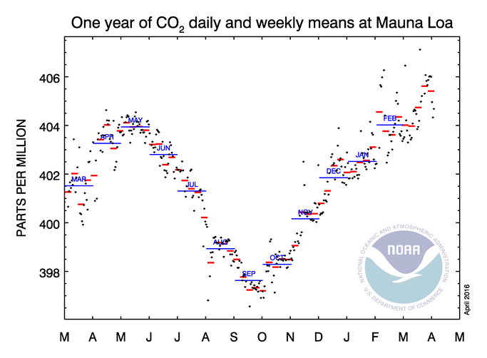
Carbon cycle
This annual cycle of CO₂ reflects the annual cycle of plant growth and decay.
In 2014, the atmosphere contained about 850 GtC* (sometimes expressed as GtCO₂).
Land biosphere contains about 2500 GtC, stored in living plants and animals, and organic carbon in soils (decaying leaves etc).
During a typical year, photosynthesis removes 120 GtC from the atmosphere. Respiration roughly balances this.
Northern hemisphere contains most of the planets land mass, and therefore most of the plants. Thus the observed monthly variation.
Large amount of carbon (1700 GtC) also stored in permafrost.
* GtC=gigatons of carbon. A gigaton is equivalent to a billion metric tons; the number means “850 million gigatons or 850 million billion metric tons" of carbon.
Atmosphere-land exchange
http://www.esrl.noaa.gov/gmd/ccgg/trends/weekly.html

Slide 8
Carbon cycle
What do the numbers mean? Need to understand the concept of ‘turnover times’.
Turnover time for the atmosphere is the length of time a carbon atom stays in the atmosphere before being transferred to land or ocean.
Can roughly estimate this according to size of the carbon reservoir (i.e. atmosphere, land or ocean). So, atmospheric reservoir (850 GtC) divided by total flux out (200 GtC, or 120 to land and 80 to mixed layer ocean), equals roughly four (years). Can also be referred to as ‘lifetime’ or ‘residence life’.
This means that a carbon atom, on average, resides in the atmosphere for four years before being transferred to land or ocean reservoirs. Since carbon is exchanged between the two, you can think of this as ‘four years to replace all of the carbon in the atmosphere with carbon from the land and ocean.

Slide 9
Carbon cycle
Turnover times for the ocean reservoirs (mixed layer and deep layer):
Total flux out of the mixed layer is 180 GtC (80 GtC exchanged with the atmosphere and 100 GtC with the deep layer), so 900 GtC total in the mixed layer divided by 180 GtC flux, equals roughly five years.
Turnover times for the deep layer is much longer; 40,000 GtC total divided by flux of 100 GtC (with mixed layer) equals about 400 years.
So, the atmosphere exchanges carbon with the land and mixed layer reservoirs relatively quickly and much more slowly with the deep ocean layer.

Slide 10
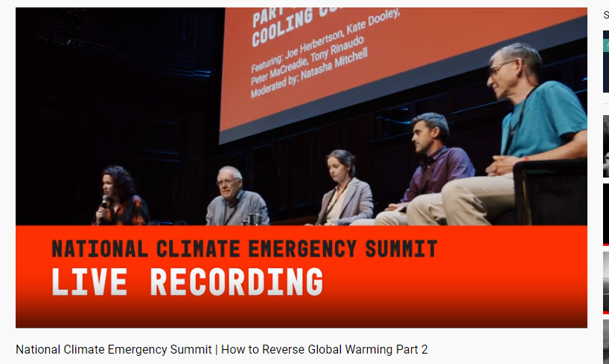
Another link to explore
https://www.youtube.com/watch?v=GreUNz693mM

